Slide 1

Disaster Messages
Categorizing disaster messages with
Natural Language Processing

Slide 2
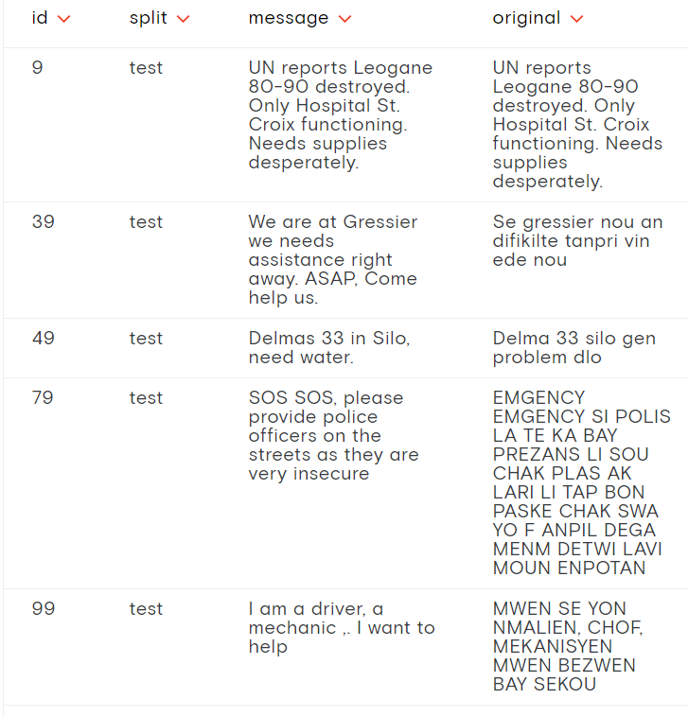
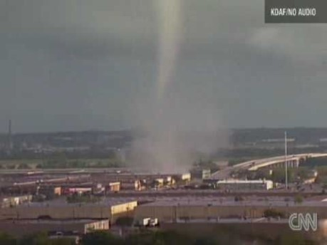
Data Source
https://appen.com/datasets/combined-disaster-response-data/

Slide 3
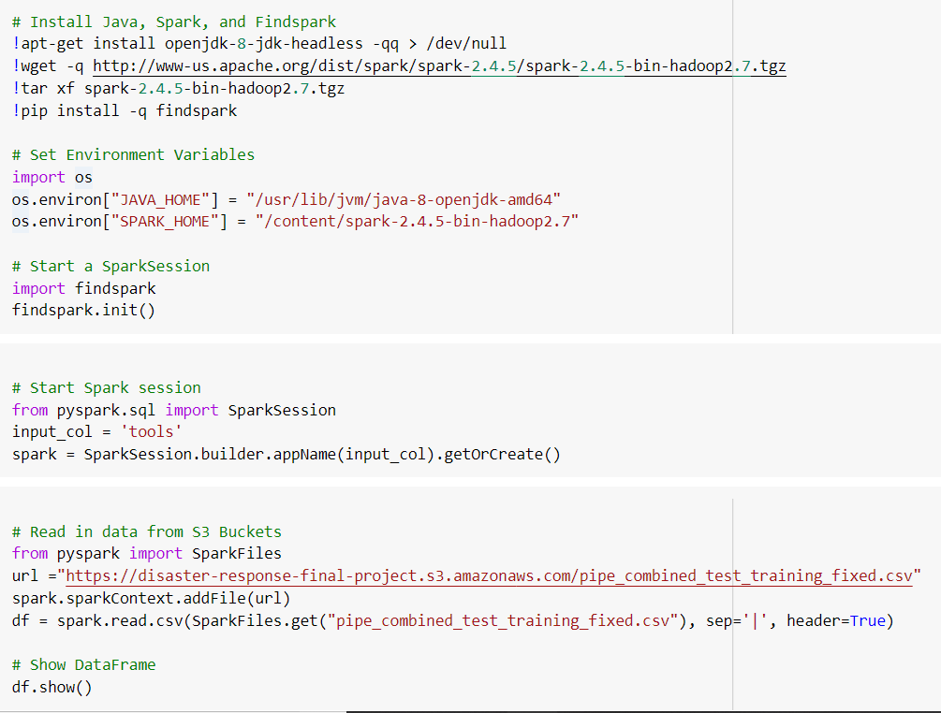
Training and Testing
With
NaiveBayes

Slide 4
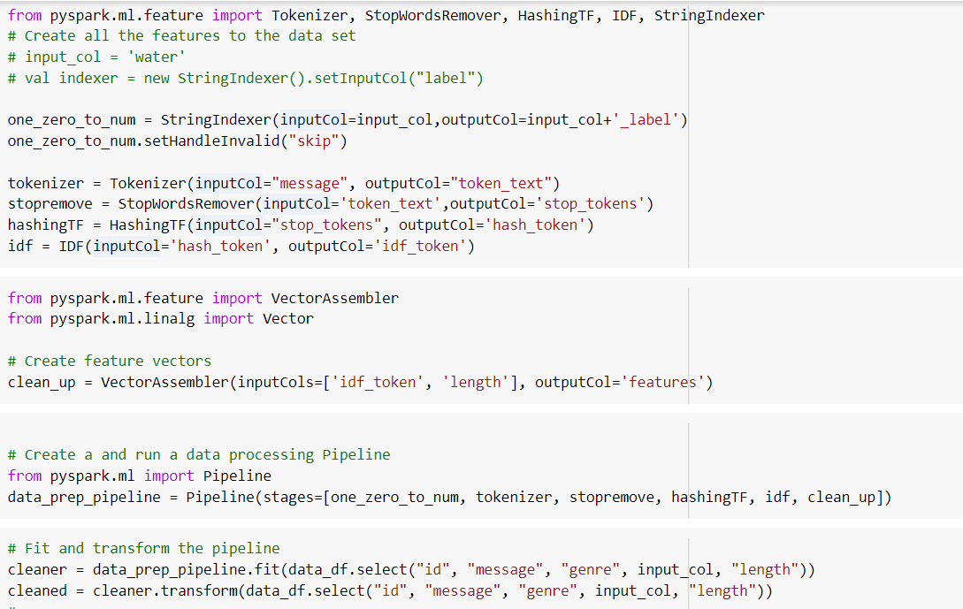

Training and Testing
With
NaiveBayes

Slide 5
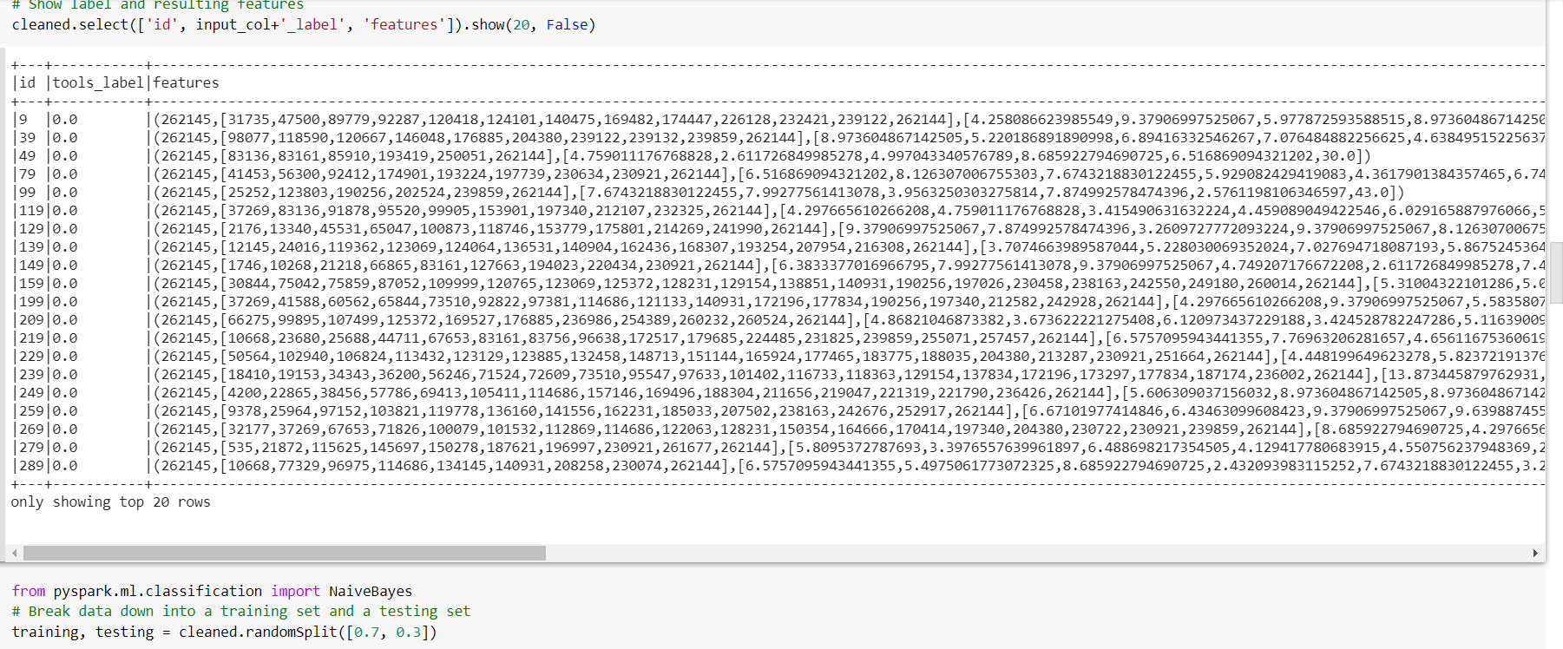
Training and Testing
With
NaiveBayes

Slide 6
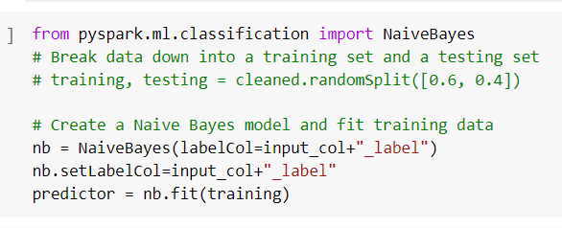
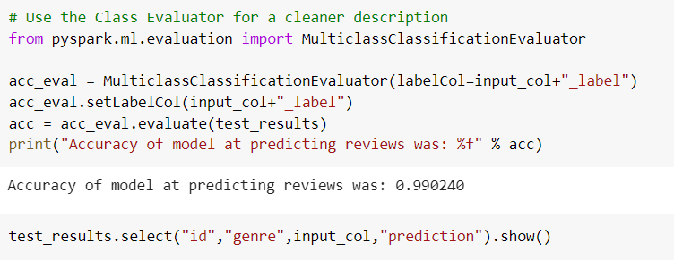
Training and Testing
With
NaiveBayes

Slide 7

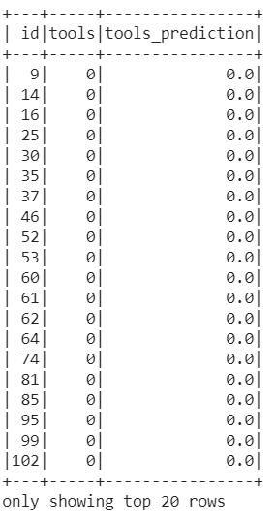

Training and Testing
With
NaiveBayes

Slide 8
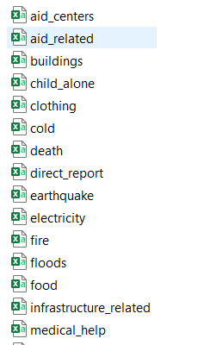
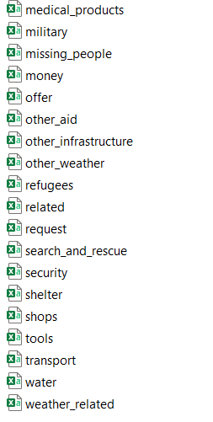
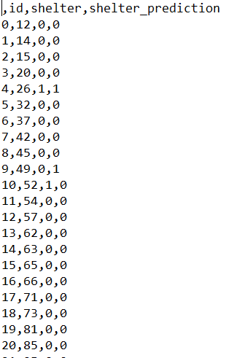
Results

Slide 9

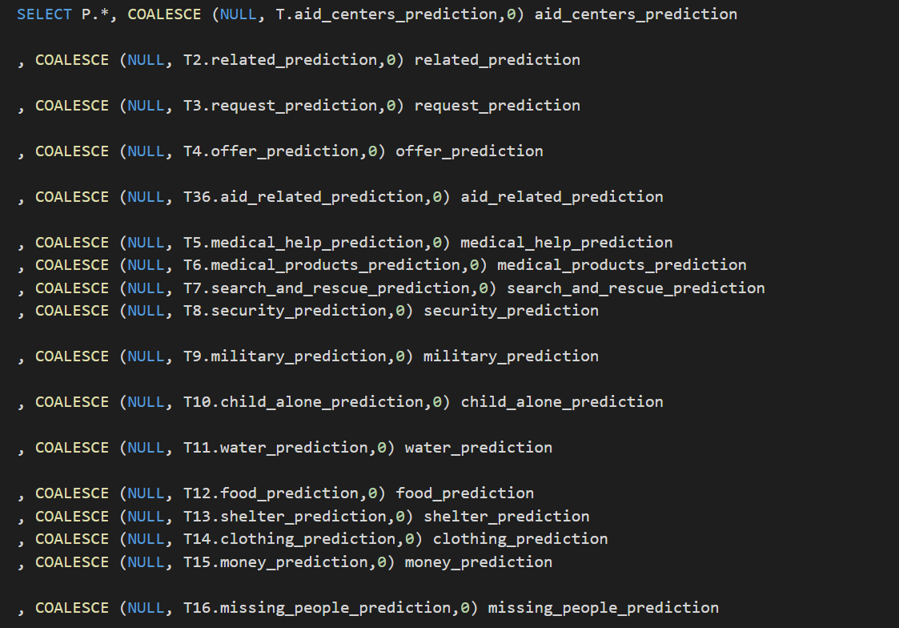
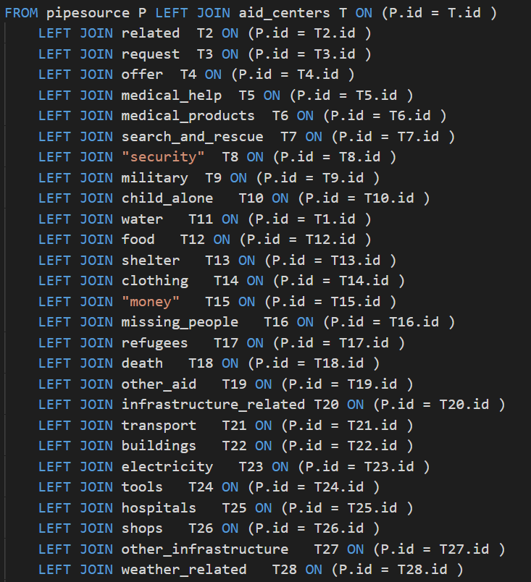
Creating A Database

